Slide 1
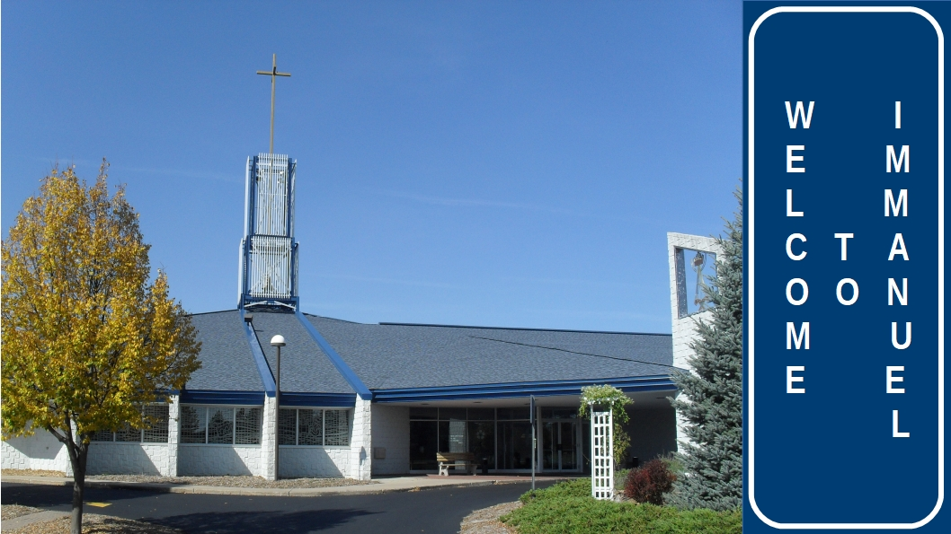

Slide 2


Slide 3
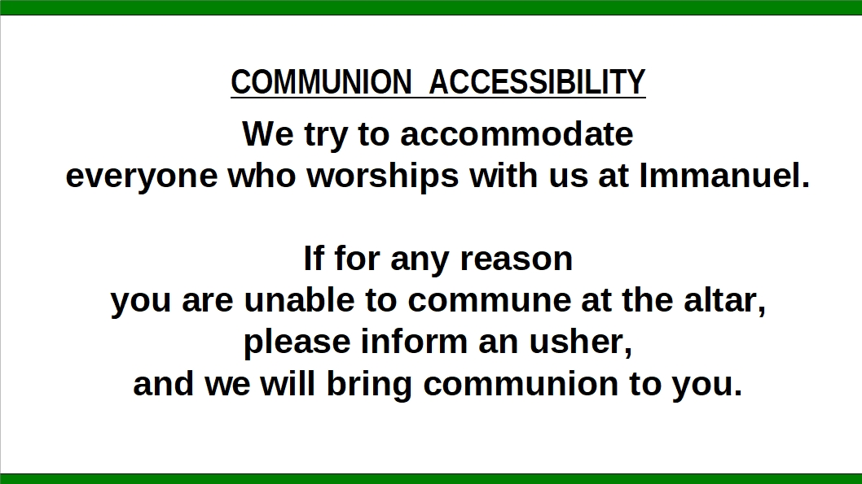

Slide 4


Slide 5
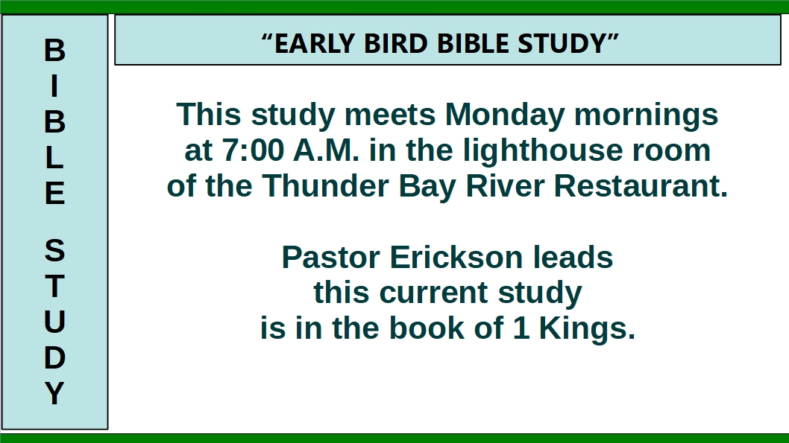

Slide 6
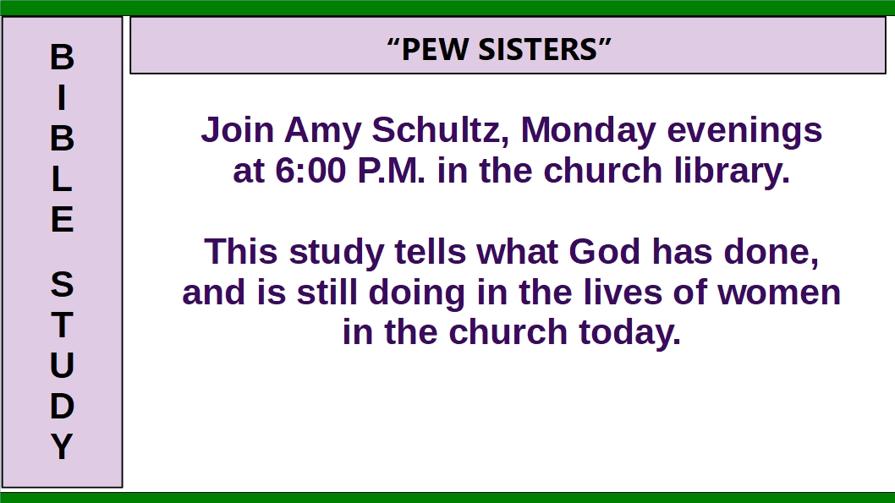

Slide 7
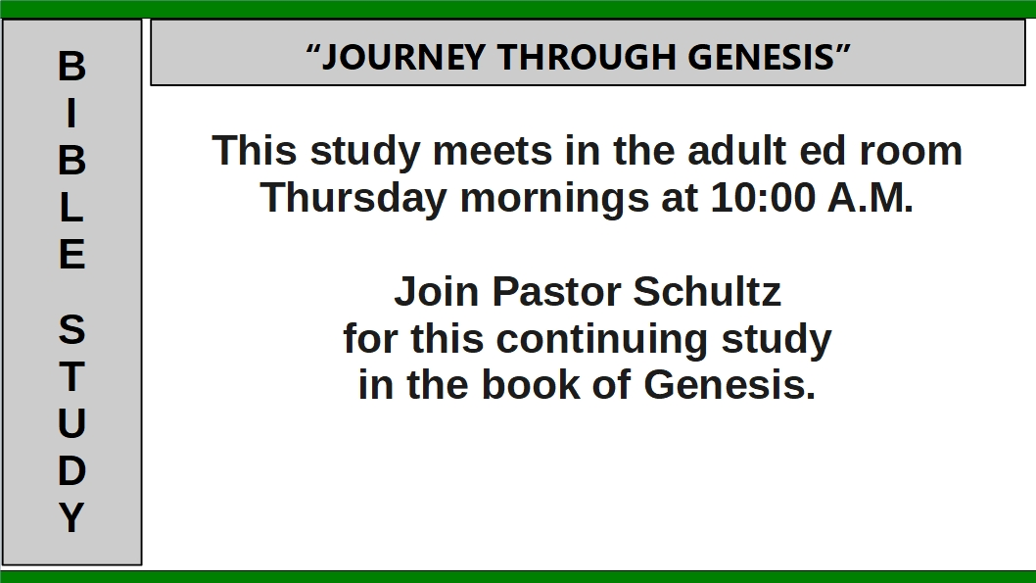

Slide 8


Slide 9
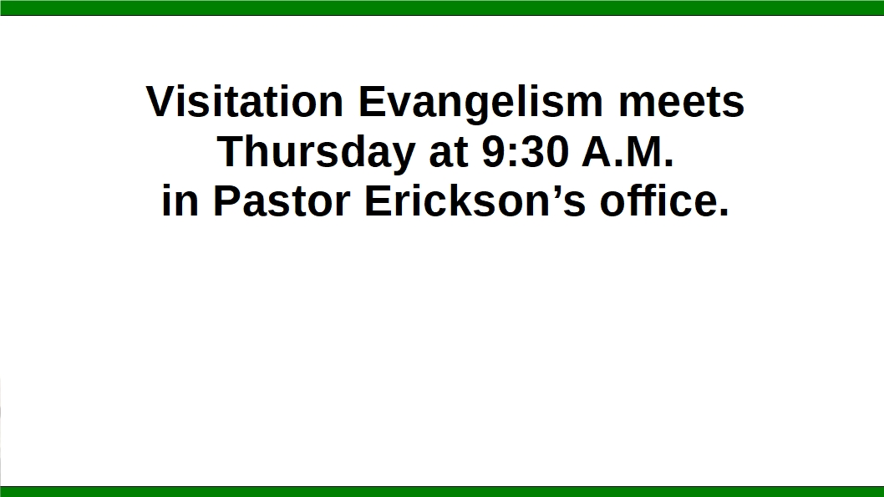


Slide 10
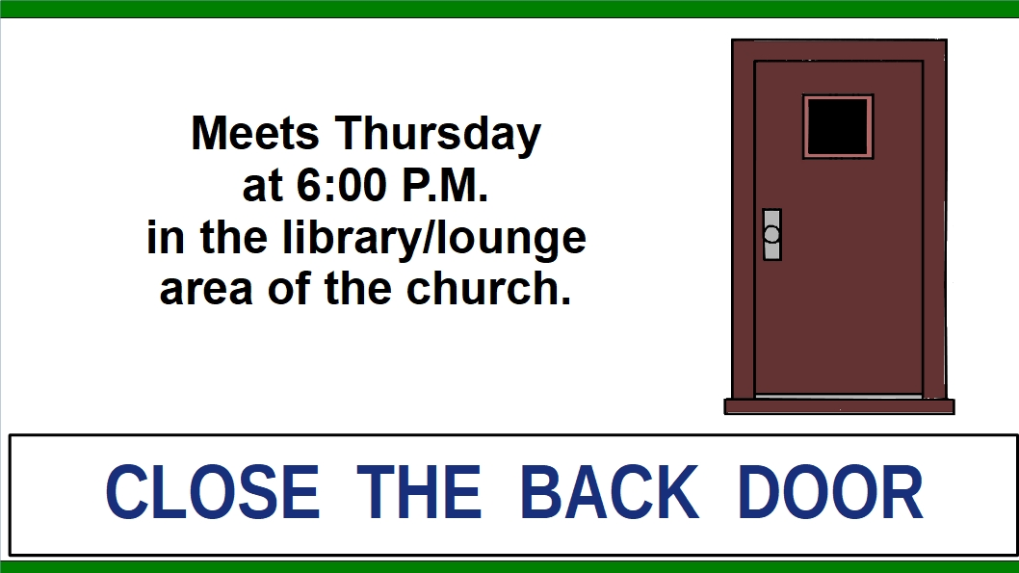

Slide 11
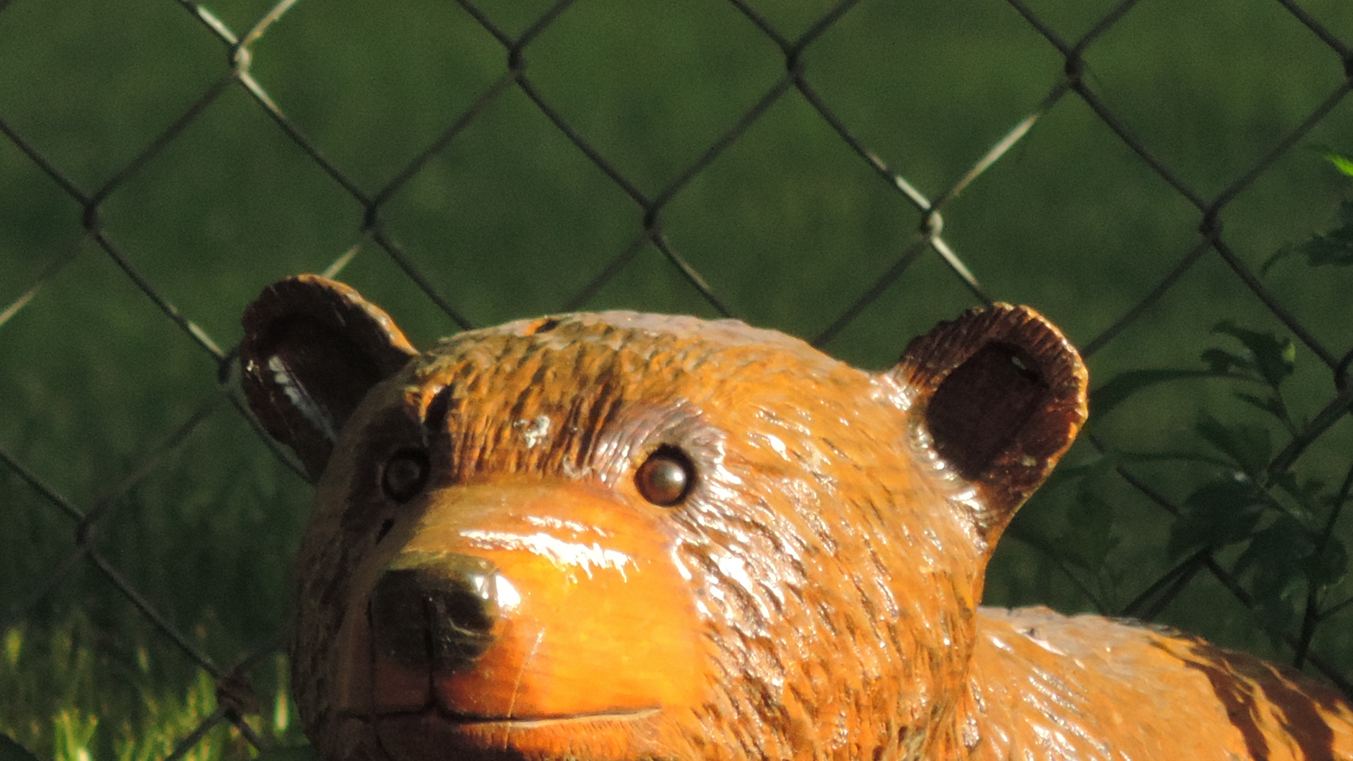
YOUTH GROUP
THURSDAYS at 6:30 p.m.
for Grades 7-12
and
College-age
Photo by N. Hoch

Slide 12


Slide 13


Slide 14

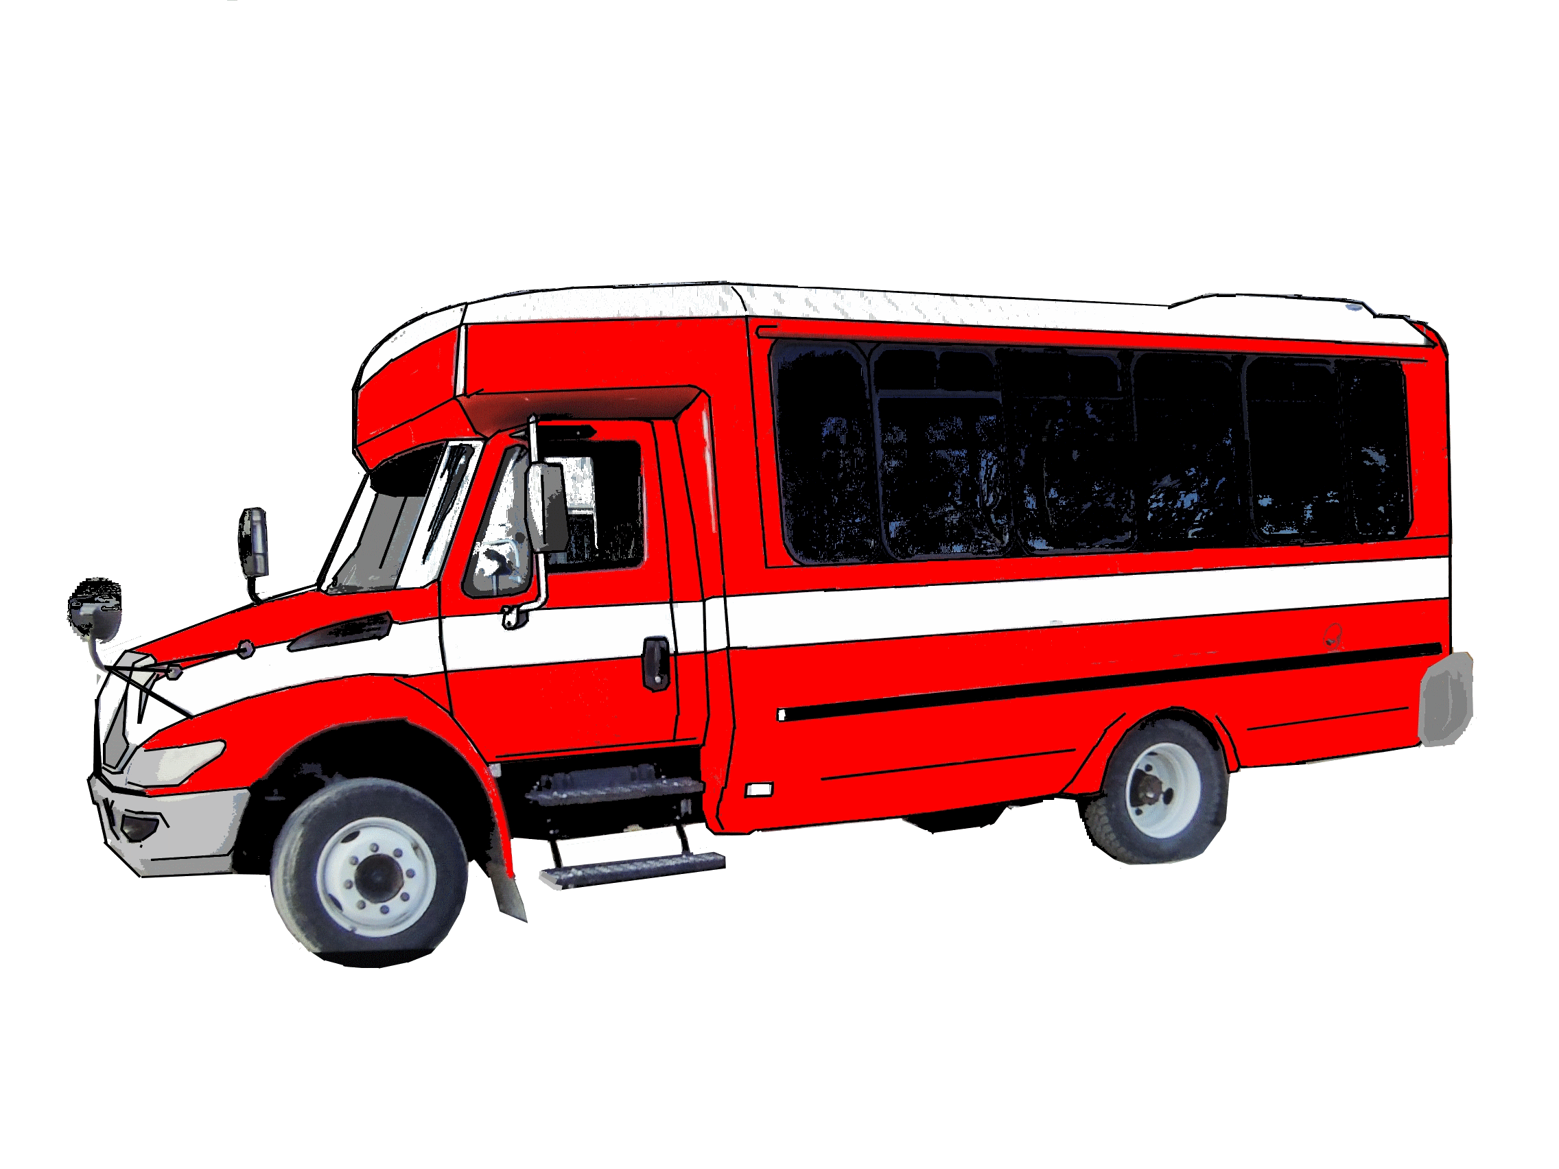

Slide 15

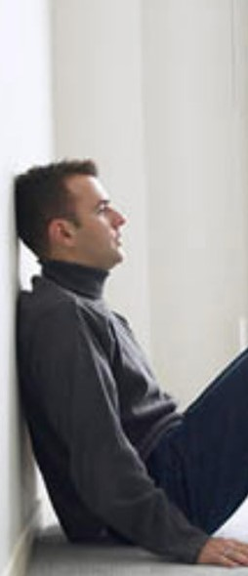


A new 13 week session begins
Tuesday, February 26th
at 6:00 P.M.
in the Youth Room.
Please contact Carol Boyd (354-3758)
or Dave Meyer (354-5864)
for more information.

Slide 16


